Slide 1
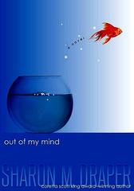
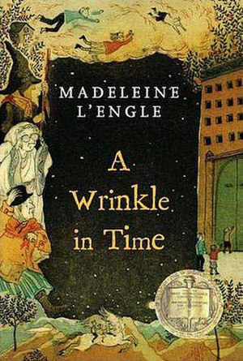
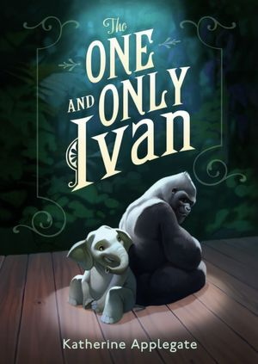
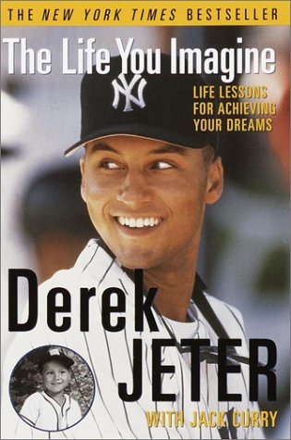
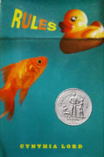
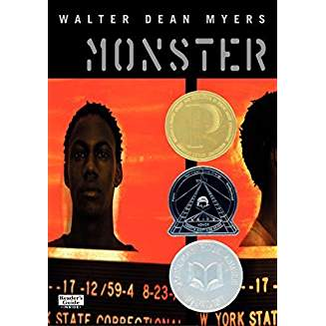
The book exchange
Joanne Robertson-Eletto

Slide 2
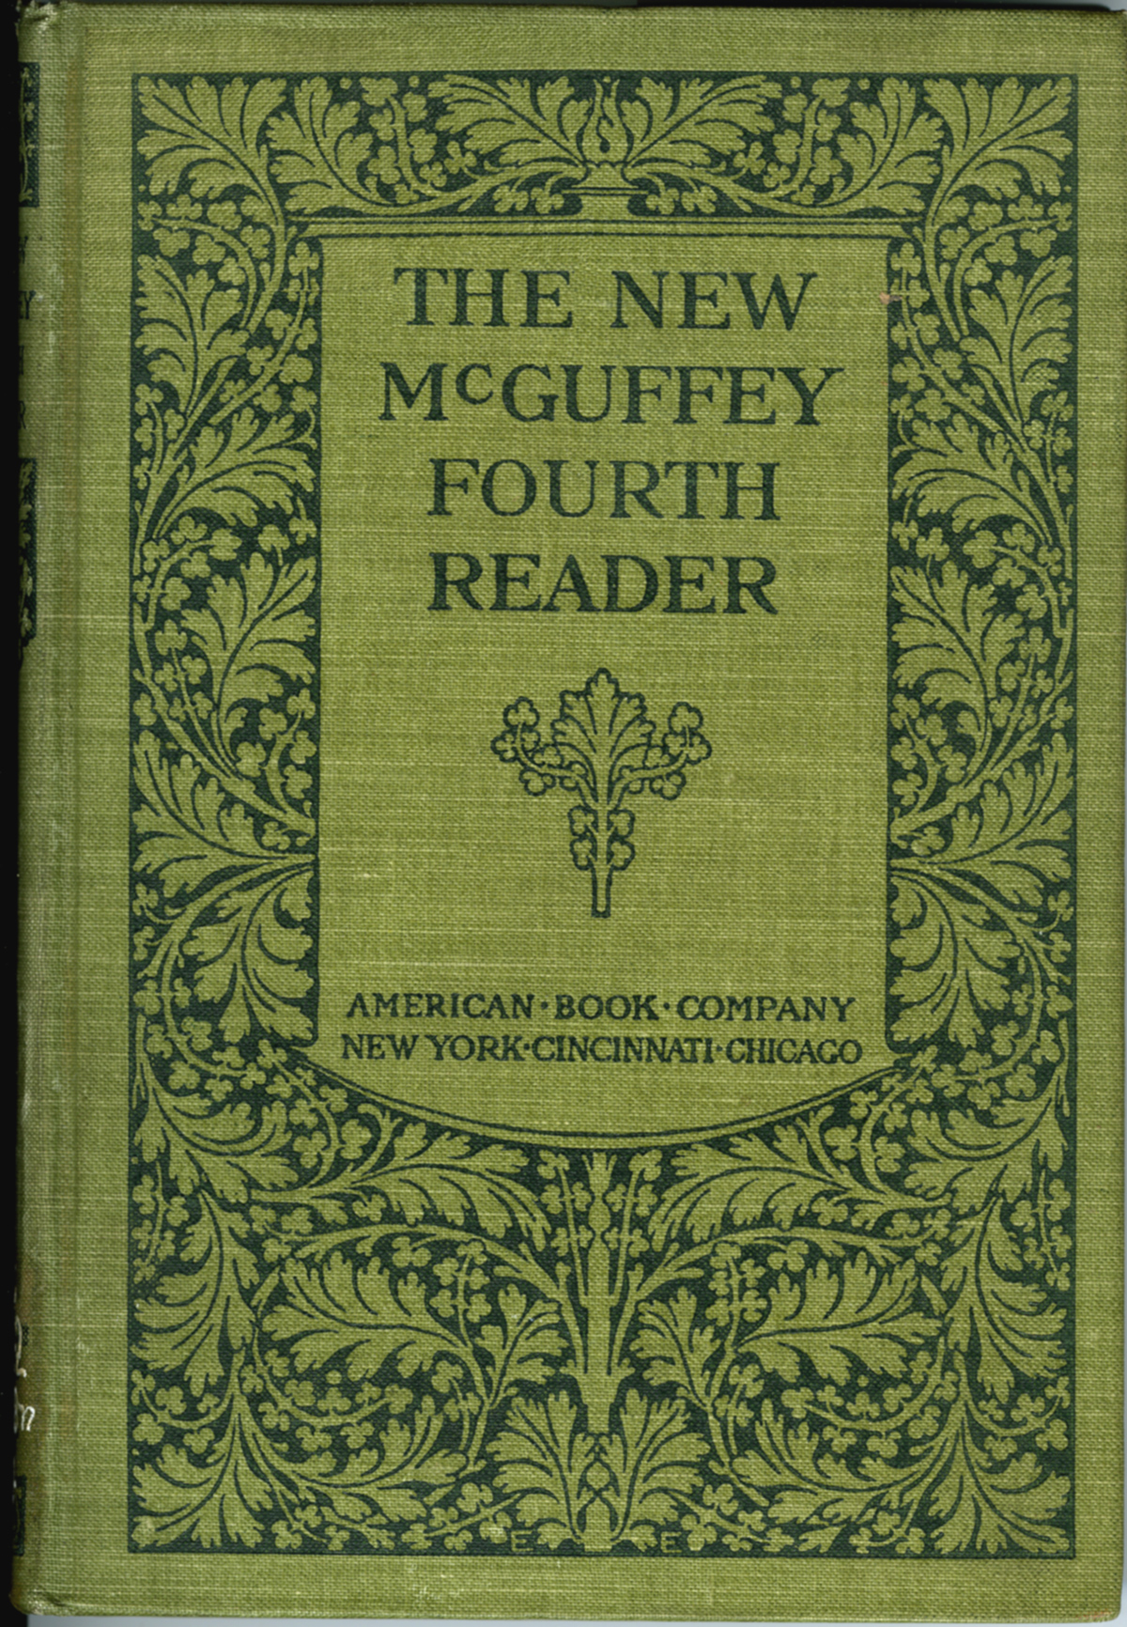
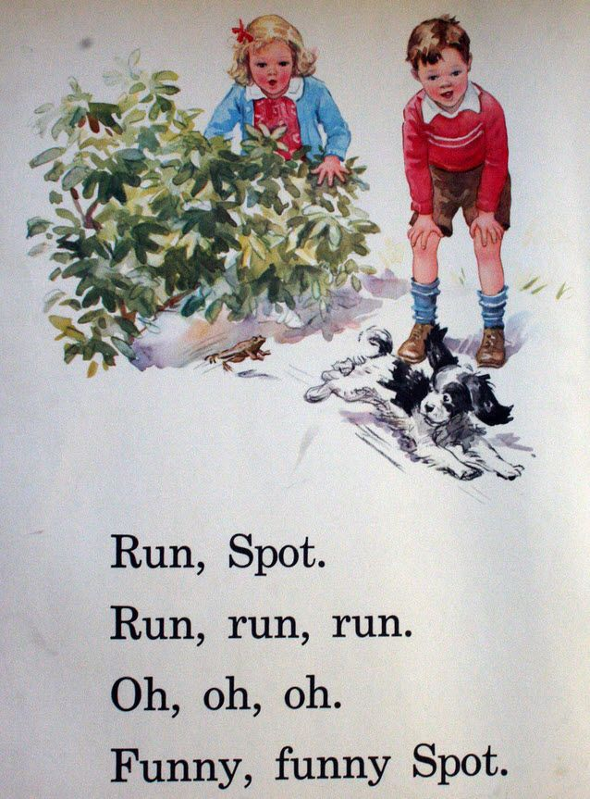
Dick and jane Books And McGuffey readers
These simplistic texts provided no room for conversation. There’s just nothing to talk or write about! Only a few words and pictures on ea each page.

Slide 3
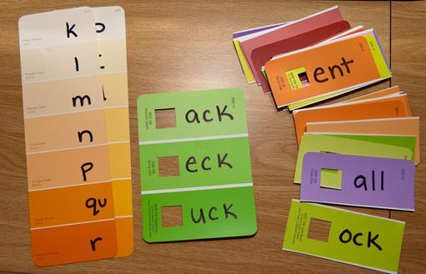
“Reading is not just about decoding the text or sounding out words. It’s a complex process of constructing meaning (s) from a text. While decoding is one of a set of skills children can use when they meet an unknown word, the research demonstrates that solely relying on heavy phonics-based approaches to teaching reading can often result in children achieving good results on tests that merely ask them to pronounce lists of words. Tasks requiring them to understand what they are reading (Krashen, 2009) require more than decoding. The best way for children to excel in reading comprehension tasks is to undertake wide reading of books they select for pleasure (Sullivan and Brown, 2013). Students who live in low socioeconomic areas are unlikely to have as many opportunities to read in this way when compared to their more affluent peers because of difficulty in accessing a wide range of quality texts at home and sometimes in school.” (Ewing and Maher, 2014)

Slide 4
A Wrinkle in time One – mrs. whatsit
It was a dark and stormy night.
In her attic bedroom Margaret Murray, wrapped in an old patchwork quilt, sat at the foot of her bed and watched the trees tossing in the frenzied lashing of the wind. Behind the trees clouds scudded frantically across the sky. Every few moments the moon ripped through them, creating wraithlike shadows that raced across the ground.
The house shook.
Wrapped in her quilt, Meg shook.

Slide 5
analyzing complexity (high)
Meaning –Multiple levels/layers of meaning
Structure –Complex, implicit, unconventional
Narration – Many shifts in point of view
Order of Events - Frequent manipulation of time and sequence (not in chronological order)

Slide 6
Language- Heavy use of abstract and/or figurative language and irony
Clarity – Generally unfamiliar, archaic, domain-specific, and/or academic language; dense and complex, may be ambiguous or purposefully misleading
Knowledge Demands
Life Experiences – Explores multiple complex, sophisticated themes; multiple perspectives presented; experiences portrayed are not fantasy but are distinctly different to the common reader
Cultural/Literary Knowledge – Requires an extensive depth of literary/cultural knowledge; many references/allusions to other texts and/or cultural elements

Slide 7
Using expository texts to analyze complexity - high
Purpose – Complex, implied, and/or difficult to determine, may have multiple purposes
Structure- Organization, text features, use of graphics
Language – Contains abstract and/or figurative language or irony. Dense and complex language that is generally unfamiliar, archaic, discipline specific, or overly academic; language may be ambiguous or purposefully misleading
Subject Matter Knowledge Demands - Intertextuality

Slide 8
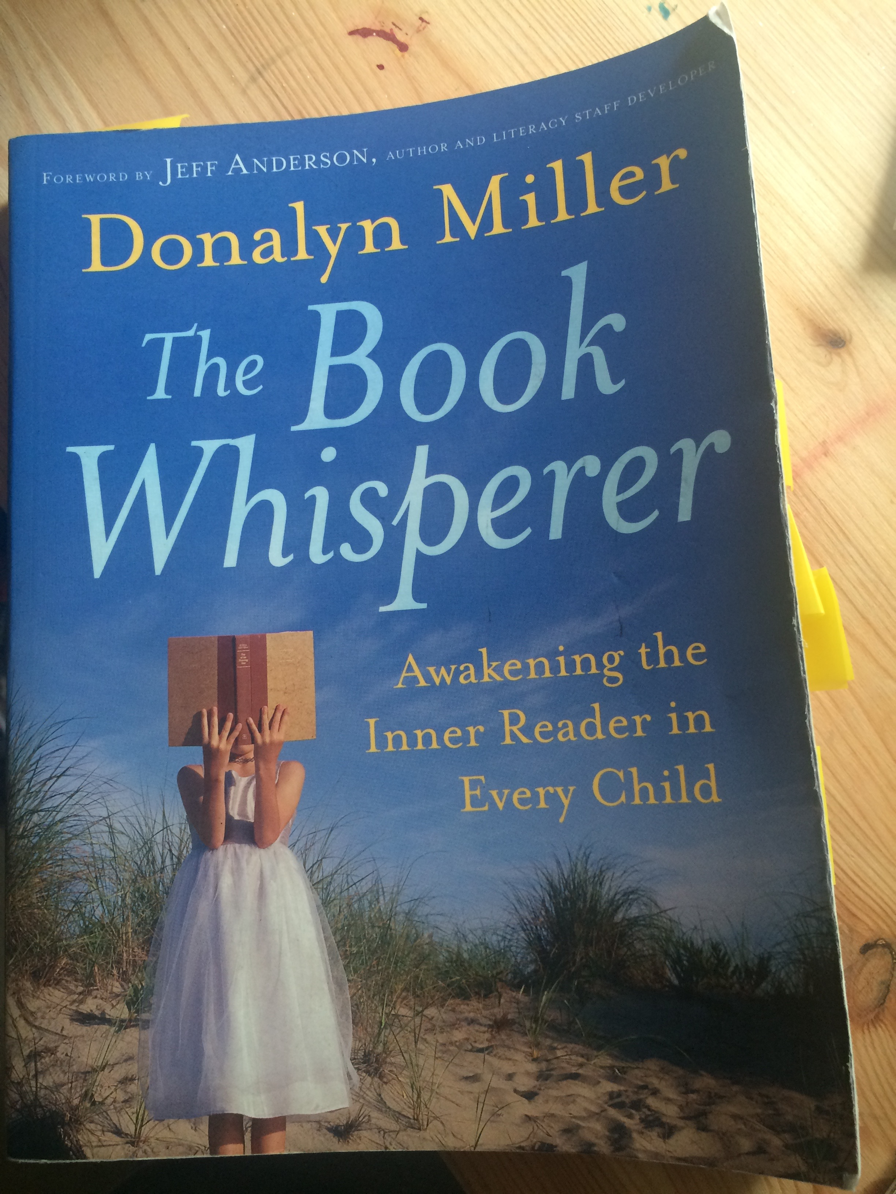
Tips from the “book whisperer” donalyn Miller
Immersion
“Students need to be surrounded with books of all kinds and given the opportunity to read them every day. Conversations about reading – what is being read and what students are getting from their books – need to be an ongoing event. In my classroom, students have access to hundreds of books of all genres and reading levels and encouragement to read widely.” p. 34

Slide 9
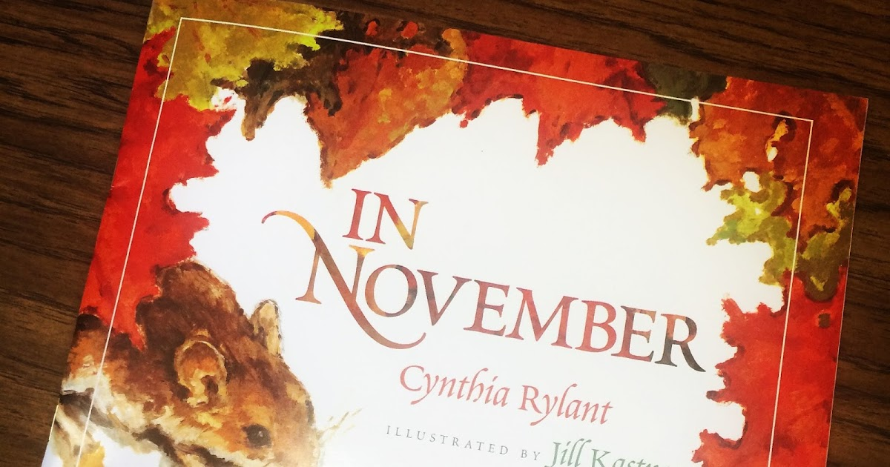
close reading: the choice is obvious!

Slide 10
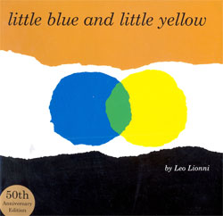
How I Choose a book REthinking THE “FIVE Finger rule”
Consider what interests my child/student.
Check out my favorite authors/illustrators.
Review Newbery Winners and Honor Books
Review Caldecott Winners and Honor Books
Review “Children’s Choices” and “Teachers Choices” - ILA
Ask the librarian or the salesperson at Barnes and Noble about “what’s hot.”

Slide 11
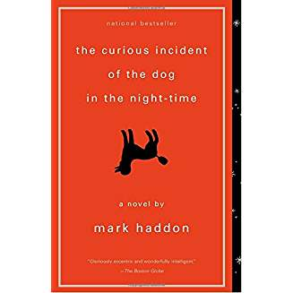
Culturally relevant literature Literature is a mirror of human life Illuminates the experiences of growing up a member of a particular cultural group

Slide 12
1 who I am- a girl named rose (rows)
I am Rose Howard, and my first name has a homonym. To be accurate, it has a homophone, which is a word that’s pronounced the same as another word but spelled differently. My homophone name is Rose…
I like homonyms a lot. And I like words too. Here is the order in which I like these thingsL
Words (especially homonyms)
2. Rules
Numbers (especially prime numbers)
I’m going to tell you a story. It’s a true story, which makes it a piece of nonfiction.

Slide 13
This is how you tell a story: First you introduce the main character. I’m writing this story about me, so I am the main character.
My first name is a homonym, and I gave my dog a homonym name too. Her name is Rain, which is special because it has two homonyms – rein and reign. I will write about Rain in Chapter Two. Chapter Two will be called “My Dog, Rain (Reign, Rein).”
Something important about the word write I that it has three homonyms – right, rite, and wright. That’s the only group of four homonyms I’ve thought of. If I ever think of another four-homonym group, it will be a red-letter day.
I live with my father, Wesley Howard, and neither of his names has a homonym.
From our porch you can see our front yard and our driveway and our road, which is called Hud Road. Road has two homonyms – rowed and rode. On the other side (sighed) of the road is a little forest, and through the trees you can see the New York Thruway. The word see has a homonym – sea. But even better, sees has two homonyms – seas and seize.
I’m in fifth grade at Hatford Elementary. There’s only one elementary school in Hatford, New York, and only one fifth-grade classroom in the school, and I’m in it.

Slide 14
I’m almost twelve because no one is sure what to do with me in school. I’ve stayed back for two semesters, which is a total of one year. (1/2 + ½ = 1.)
Some of the things I get teased about are following the rules and always talking about homonyms. Mrs. Leibler is my aide and she sits with me in Mrs. Kushel’s room. She sits in an adult-size chair next to my fifth-grade-size chair and rests her hand on my arm when I blurt something out in the middle of math. Or, if I whap myself in the head and start to cry, she’ll say, “Rose, do you need to step into the hall for a moment?”
Mrs. Liebler tells me there are things worth talking about besides homonyms, rules, and prime numbers. She encourages me to think of conversation starters. Some conversation starters about me that do nor have anything to do with homonyms or rules or prime numbers are:
I live in a house that faces northeast. (After I say that I ask the person I’m trying to have a conversation with, “And which direction does your house face?”)
Down the road, 0.7 miles from my house is J&R Garage, where my father sometimes works as a mechanic. And 0.1 miles farther along is a bar called The Luck of the Irish

Slide 15
where my father sometimes goes after work. There is nothing between my house and J& R Garage except trees and the road (Tell me some things about your neighborhood).
I have an Uncle named Weldon, who is my father’s younger brother. (And who else is in
your family?)
My official diagnosis is high-functioning autism, which some people call Asperger’s
syndrome. (Do you have a diagnosis?)

Slide 16
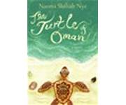
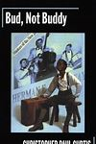
Books for a global society

Slide 17
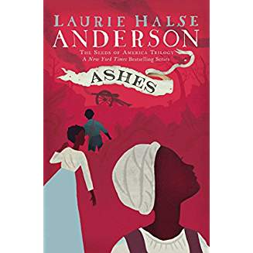
Laurie Halse Anderson

Slide 18
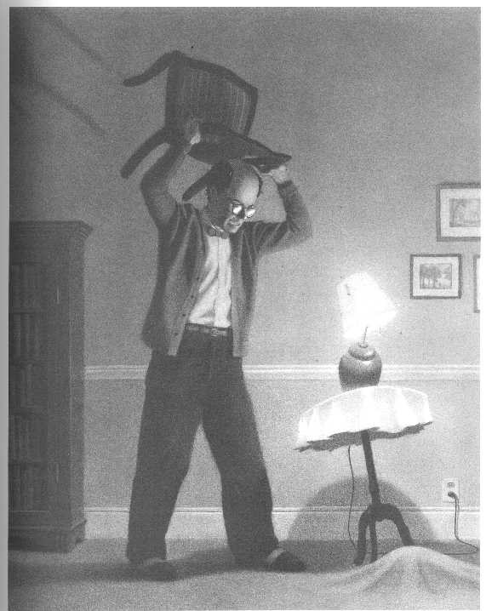
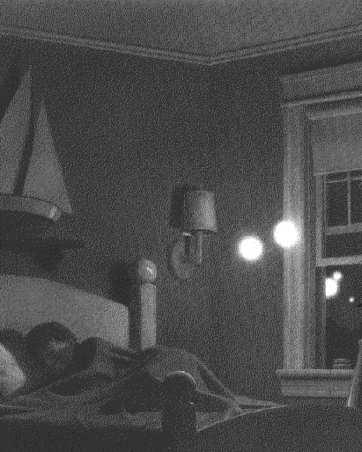
The Mysteries of Harris burdick – Van Allsburg

Slide 19
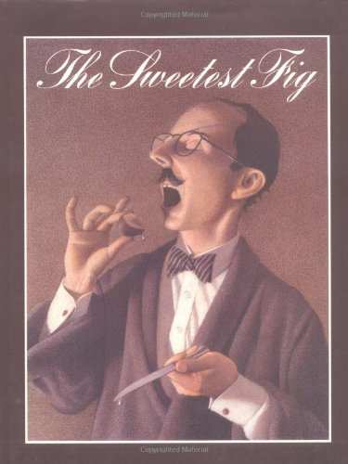

Slide 20
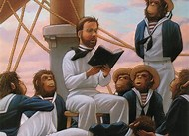
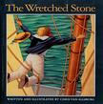
The Wretched stone – chris van allsburg
“
It is a rock, approximately two feet across. It is roughly textured, gray in color, but a portion of it is as flat and smooth as glass. From this surface comes a glowing light that is quite beautiful and pleasing to look at. The thing is unbelievably heavy, requiring six strong men to lift it. With great effort we were able to get it aboard and into the forward hold. We have set sail and are underway again.
Journal of Captain Randall Ethan Hope
Captain, the Rita Ann

Slide 21
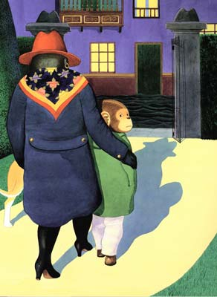
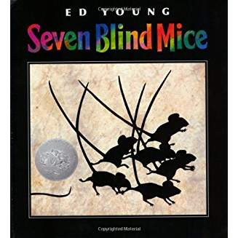
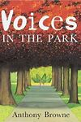
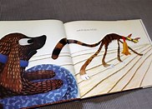
Voices in the park
THEY ALL SAW A CAT
SEVEN BLIND MICE

Slide 22
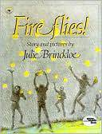
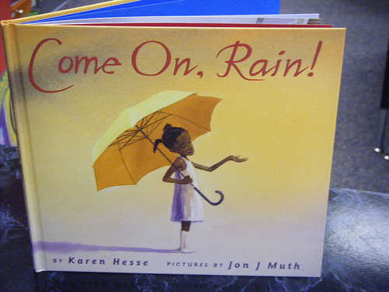
Fireflies Come on, rain!

Slide 23
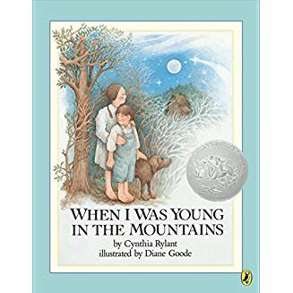
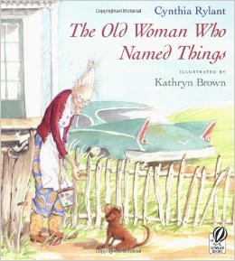
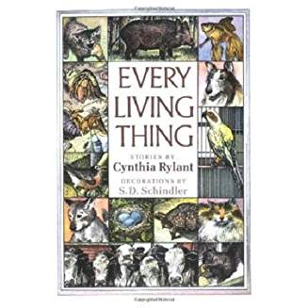
Cynthia rylant

Slide 24
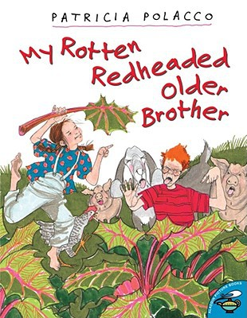
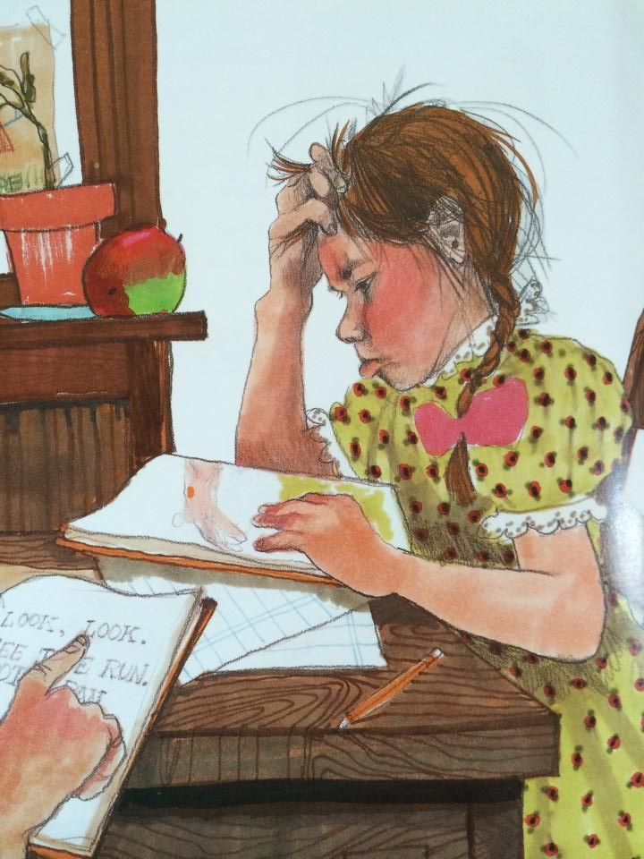
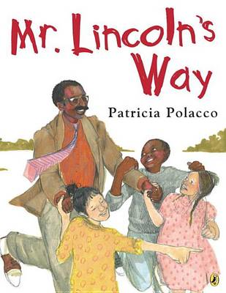
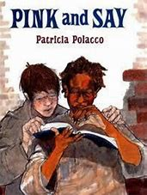
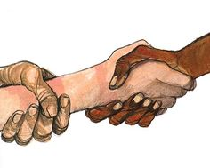
Patricia Polacco

Slide 25
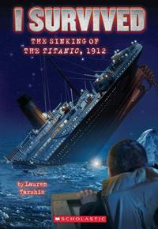
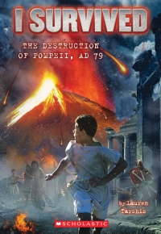
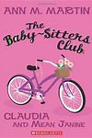
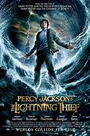
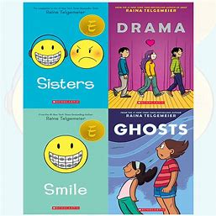
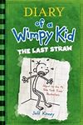
Children’s choices Lemonade war & I survived series

Slide 26
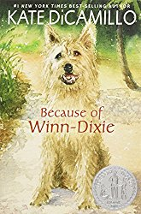
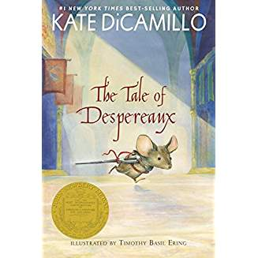
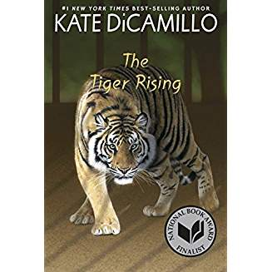
Kate di Camillo

Slide 27
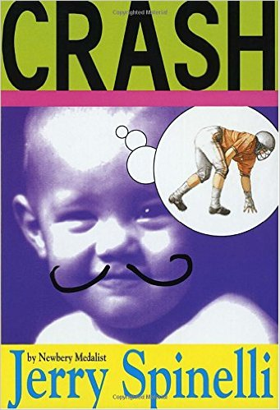
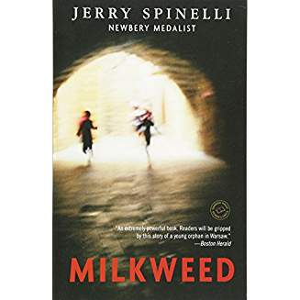
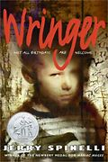
Jerry Spinelli

Slide 28
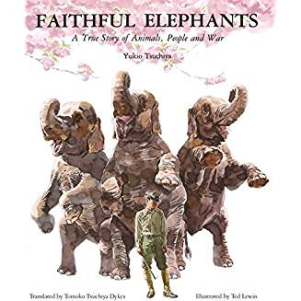
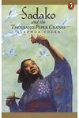
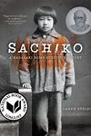
War

Slide 29
The Life We bury – chapter one
I remember being pestered by a sense of dread as I walked to my car that day, pressed down by a wave of foreboding that swirled around my head and broke again the evening in small ripples. There are people in the world who would call that kind of feeling a premonition, a warning from some internal third eye that can see around the curve of time. I’ve never been one to buy into things. But I will confess that there have been times when I think back to that day and wonder: If the fates had truly whispered in my ear – and if I had known that drive would change so many things – would I have taken a safer path? Or would I still travel the path that led me to Carl Iverson?

Slide 30
The Holocaust

Slide 32
Nancy Tafuri

Slide 33
Kevin Henkes

Slide 34
Structure and ways with words

Slide 35
Rubric for narrative writing – Teachers college – Grade 5
Lead
The writer wrote a beginning in which she not only showed what was happening and where, but also gave some clues to what would later become a problem for the main character.
Elaboration
The writer developed characters, setting, and plot throughout her story. To do so, she used a blend of description, action, dialogue, and thinking.

Slide 36
Double Points awarded for these categories
Elaboration
The writer developed characters, setting, and plot throughout her story, especially the heart of the story. To do this, she used a blend of description, action, dialogue, and thinking.
Craft
The writer showed why characters did what they did by including their thinking and their responses to what happened.

Slide 37
Craft (continued)
The writer slowed down the heart of the story. He made less important parts shorter and less detailed and blended storytelling and summary as needed.
The writer used precise details and used figurative language so readers could picture the setting, characters, and events, He used some objects and actions as symbols to bring forth his meaning.
The writer varied his sentences to create the pace and tone of his narrative.

Slide 38
La Princesa and the pea

Slide 39
Freedom over Me

Slide 40
Teaser – “Paint and Poetry”
There were but three of a household of slaves who were sold when a plantation’s properties went up for auction. A herd of cattle was priced at $864. A handmill, $1. Stephen was worth $300; Peggy, $150; Qush, $100. They were real people from a rel plantation listed in a real document discovered by Ashley Bryan. In his monumental tribute to the strength of the human spirit and power of hope…Every slave was so much more than that cruel moniker: They were individuals, each a person who had a dream.

Slide 42
1. iN Which a Story is told
Yes.
There is a witch in the woods. There has always been a witch.
Will you stop your fidgeting child for once? My stars! I have never seen such a fidgety child.
No, sweetheart, I have not seen her. No one has, Not for ages. We’ve taken steps so that we will never see her.
Terrible steps.
Don’t make me say it. You already know anyway.
Oh, I don’t know darling. No one knows why she wants children. We don’t know why she insists it must always be the very youngest among us. It’s not as though we could ask her. She hasn’t been seen. We make sure that she will not be seen.

Slide 43
Medieval times – persecution and religious freedom (12 and up) is illuminated as a medieval text would have been

Slide 44
On a dark night in 1242, travelers gather at a small French inn. It is the perfect night for a story and everyone in the kingdom is consumed by the tale of three children: Jeanne, a peasant girl who has visions of the future; William, a young monk with supernatural strength; and Jacob, a Jewish boy who can heal any wound. Together their powers will be tested by demons and dragons, cruel knights and cunning monks. From small village to grand banquet halls, these three unlikely friends – and their faithful greyhound – are chased through France to a final showdown in the waves at the foot of the abbey-fortress of Mont-Saint-Michel.

Slide 45
The king is ready for war.
Louis of France is not yet thirty, and already he is the greatest king in Europe. He loves his subjects, He loves his God. And his armies have never been defeated.
This war, though, is different.
He is not fighting another army.
He is not fighting another king.
He is fighting three children.
And their dog.

Slide 46
SCYTHE - Teaser
Thou shalt kill –
A world with no hunger
No disease
No war
No misery.
Humanity has conquered all those things. Now scythes are the only ones who can end life – and they are commanded to do so, in order to keep the size of the population under control.

Slide 47
Part One Robe and ring
We must, by law, keep a record of the innocents we kill.
And as I see it, they’re all innocents. Even the guilty. Everyone is guilty of something, and everyone still harbors a memory of childhood innocence, no matter how many layers of life wrap around it. Humanity is innocent; humanity is guilty, and both states are undeniably true.
We must, by law, keep a record.

Slide 48
Newbery award winner – 2018 Caldecott winner - 2018

Slide 49
Wolf in
the Snow

Slide 50
For our final practicum meeting
Bring one of your favorite mentor texts and a teaching idea to go with it. A lesson plan is not necessary – bring enough copies for the class.

